Slide 1
Molecular Motors
Jean V Bellissard
Georgia Institute of Technology
School of Physics
Fall 2015

Slide 2
Cell Activity
Cell division: chromosome replicate, segregate into two daughter cells
Flagella: wiggle around to move sperm, cilia beats to avoid accumulation of mucus in lungs
Nerve cells: fire by vesicle moving around to deliver neurotransmitters
How do such movements happen ?

Slide 3
Molecular Motors
Fuel: Adenosine Triphosphate (ATP) is the
cellular source food
Engine: proteins using the ATP to move
How far do they move?
few microns in typical cells
about a meter along nerves
Efficiency: how come they operate at about
100% efficiency ? (!!!)

Slide 4
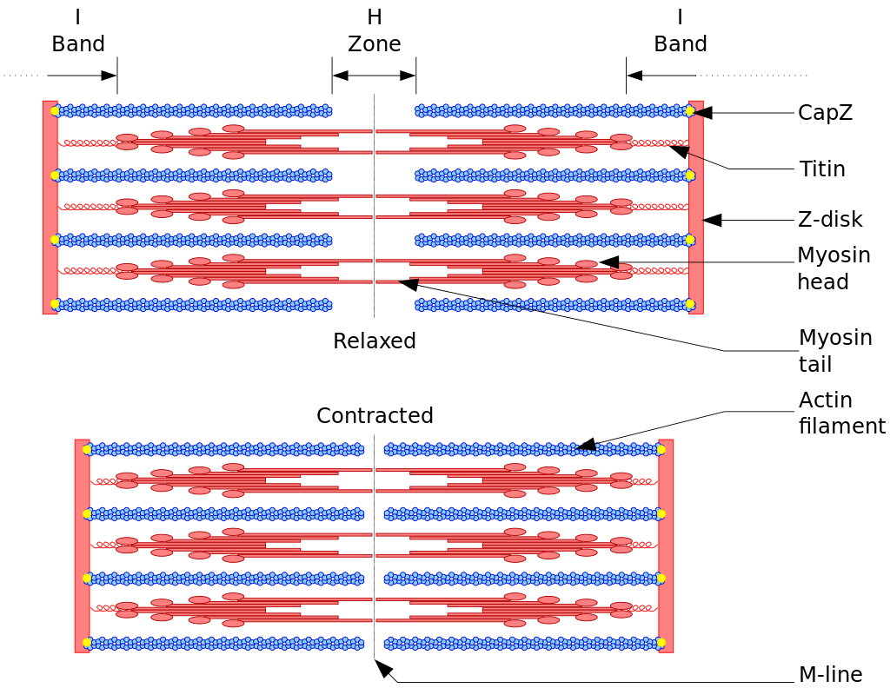
Myosin-Actin in muscle cells

Slide 5
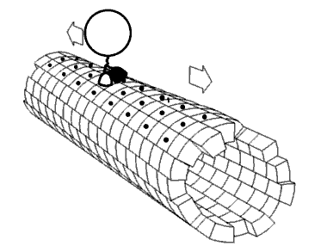
Kinesin-Microtubule in cells

Slide 6
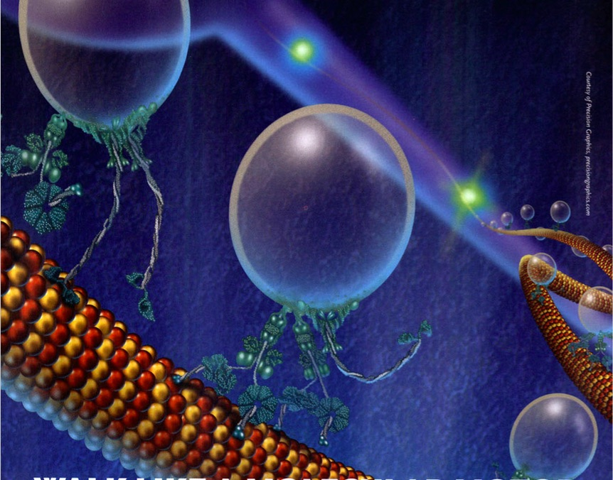
Kinesin-Microtubule in cells

Slide 7
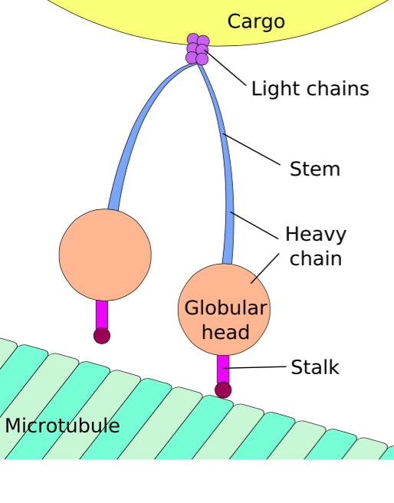
Dynein-Microtubule in cells

Slide 8
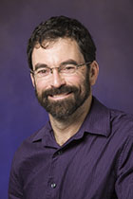
Kinesin-microtubule experiments
P.R. Selvin’s group (U. Illinois, Urbana-Champaign) led a series of experiments between 2002-07 to measure the movement of the kinesin.
The protein is walking like a human being.
Steps are 8.3 nm long

Slide 9
Kinesin-microtubule experiments
A light microscope cannot discriminate a distance less than 250nm!
A new technique called Fluorescence Imaging with One Nanometer Accuracy was developed (FIONA, Ahmet Yildiz).
FIONA has a spatial resolution of 1.5nm!!
Myosin, kinesin and dynein move in hand-over-hand fashion, namely they walk!

Slide 10
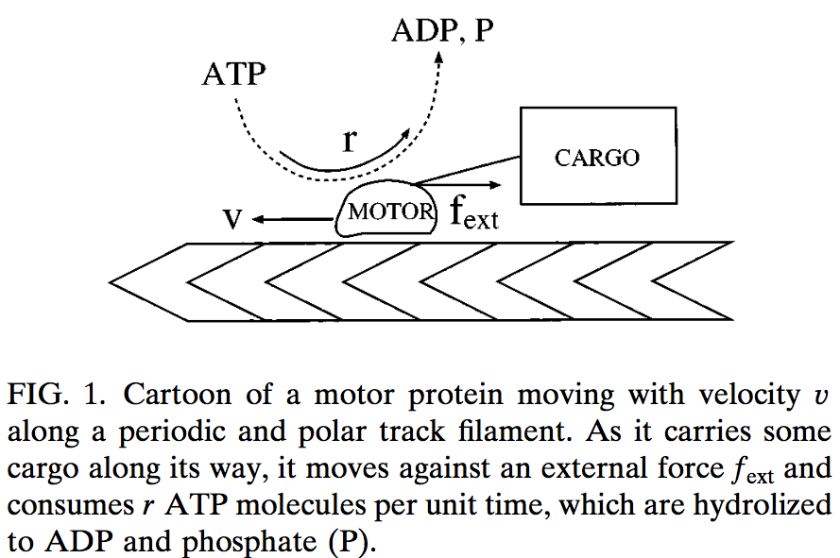
Kinesin-microtubule modeling

Slide 11
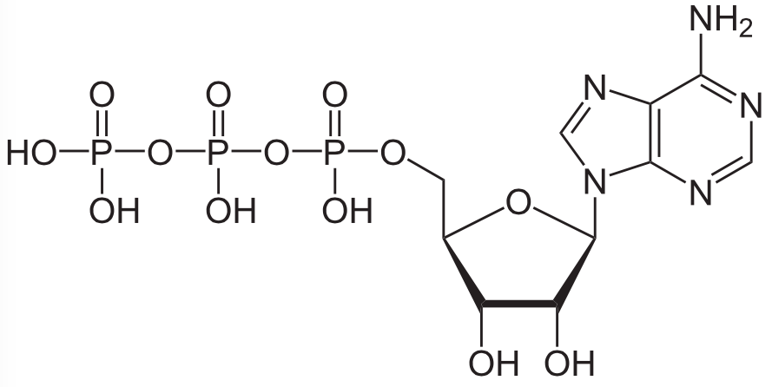
Adenosine-triphosphate (ATP)

Slide 12
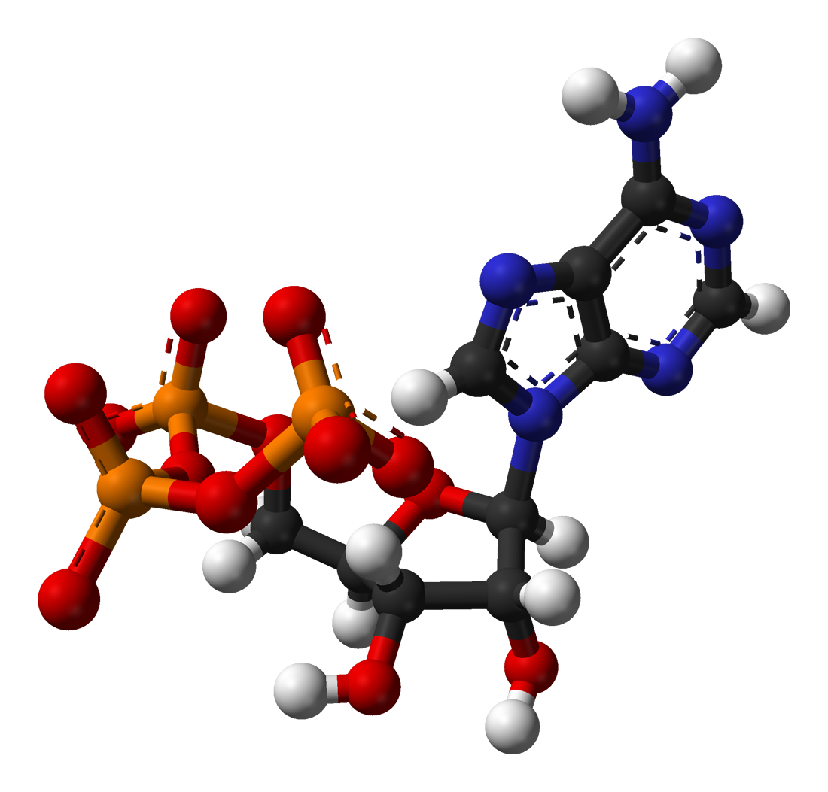
Adenosine-triphosphate (ATP)

Slide 13
Adenosine-triphosphate (ATP)
ATP → ADP, AMP hydrolysis
(P_{i}=phosphate, Ppi=pyrophosphate)
ATP + H₂O → ADP + P_{i} ΔG˚ = −30.5 kJ/mol
(−7.3 kcal/mol)
ATP + H₂O → AMP + PP_{i} ΔG˚ = −45.6 kJ/mol
(−10.9 kcal/mol)

Slide 14
Adenosine-triphosphate (ATP)
Living cells maintain the ratio of ATP to ADP at a point ten orders of magnitude from equilibrium, with ATP concentrations fivefold higher than the concentration of ADP.
The hydrolysis of ATP in cells release a large amount of free energy
Δμ=μ_{ATP}-μ_{ADP}-μ_{P} is large ≅ 10k_{B}T
(non-linear regime) [exp(-Δμ/k_{B}T)=e⁻¹⁰ ]
f_{ext}=external force (friction, cargo)
r = ATP consumption rate,
v = velocity of the protein

Slide 15
Protein-microtubule modeling
Microtubules are rigid, periodic with
period ≅ 10nm, polar, asymmetric.
Fastest motor characteristic time O(1ms).
Return to equilibrium time O(100ns).
Local equilibrium approximation applies.
Each protein molecule can be in at least 2 states depending upon the presence of ATP.

Slide 16
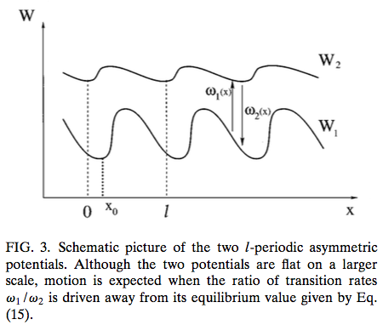
Protein-microtubule modeling

Slide 17
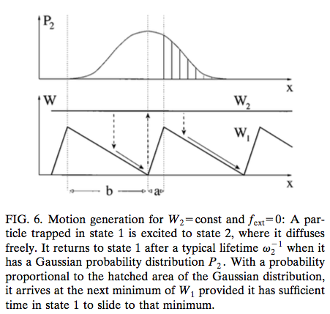
Protein-microtubule modeling
Ratchet model

Slide 18
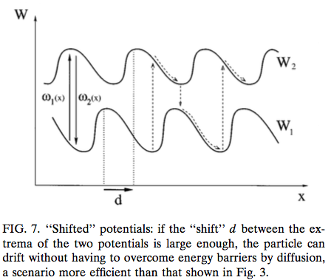
Protein-microtubule modeling

Slide 19
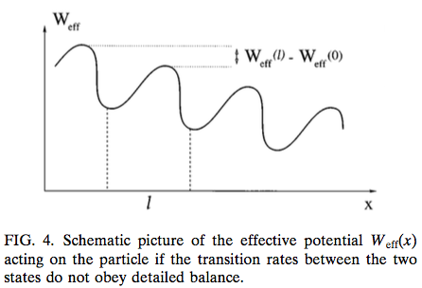
Protein-microtubule modeling

Slide 20
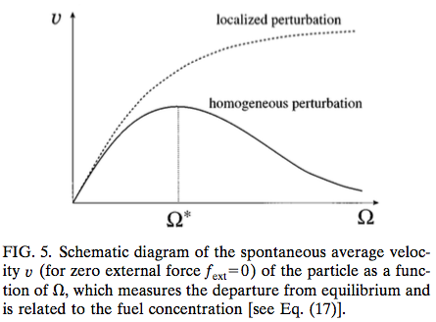
Protein-microtubule modeling

