Slide 1
Brain
Jean V Bellissard
Georgia Institute of Technology
School of Physics
Fall 2015

Slide 2
Introduction
Population of neurons are responsible for the neurological functions emerging out of complex animal brains.
Nervous system, motor system, organ functions, blood distribution, are controlled by the brain, using group of neuron as initiators

Slide 3
Introduction
New techniques emerges since 1990 to investigate neuron behavior: multi-site, multi-electrode recording CMMR
These microelectrodes are censor to record electrical sparks: action potential
100,000 neurons are recorded, the censors can be used for months
2000: Brain-Machine-Interface (BMI)

Slide 4
Brain-Machine Interface

Slide 5
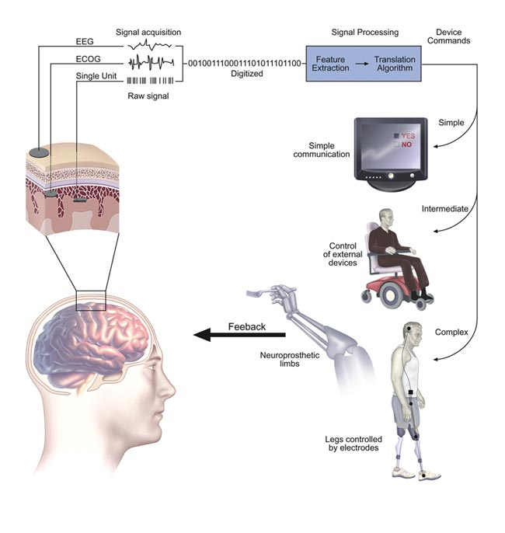
BMI

Slide 6
BMI
Potential of BMI for therapies, using neuroprosthetic devices
Visual implant can simulate images
Auditory implants (cochlear implants)
Spinal cord simulators, pacemakers,
Brain-computer interfaces

Slide 7
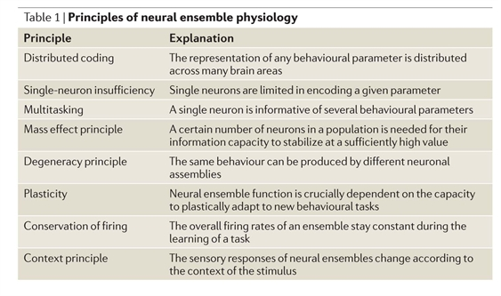
BMI
Miguel A. L. Nicolelis & Mikhail A. Lebedev
Nature Reviews Neuroscience 10, 530-540 (July 2009)

Slide 8
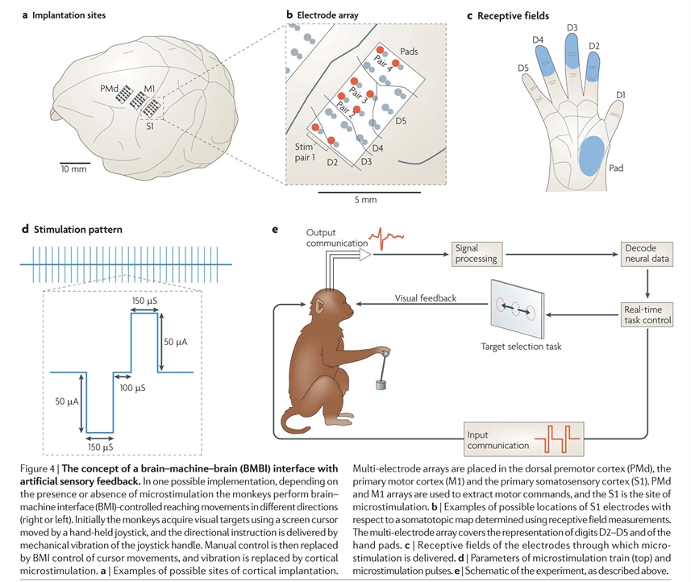
BMI

Slide 9
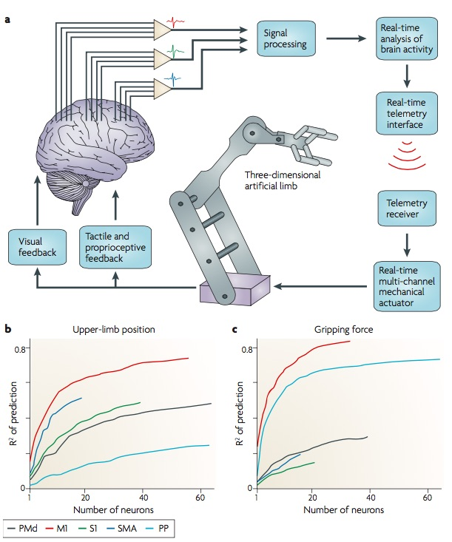
BMI

Slide 10
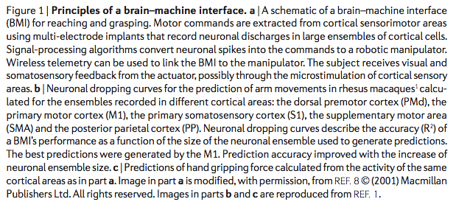
BMI
Miguel A. L. Nicolelis & Mikhail A. Lebedev
Nature Reviews Neuroscience 10, 530-540 (July 2009)

Slide 11
BMI
Evidence suggests that the
same combination of neurons is never repeated to produce the same movement
(M. Pais-Vieira, M.A. Lebedev, M.C. Wiest, M.A. L. Nicolelis
The Journal of Neuroscience, 33, 4076–4093, (2013))

Slide 12
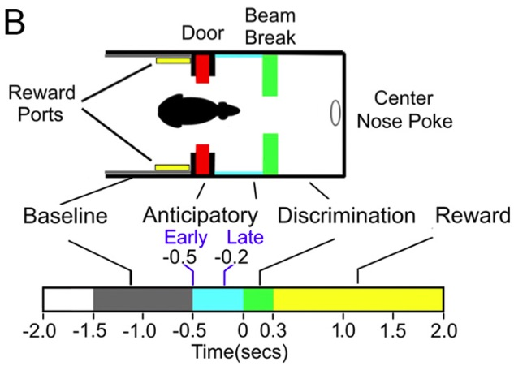
BMI

Slide 13
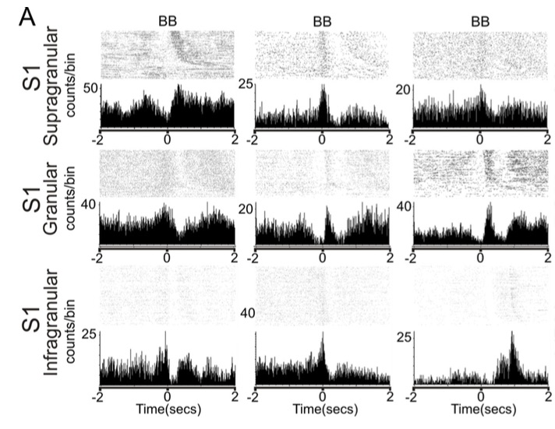
BMI
Anticipatory
activity
Cortical
Areas: S1

Slide 14
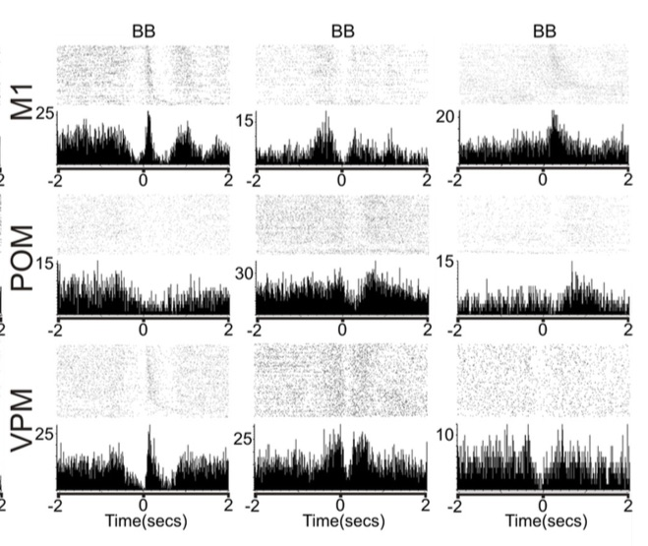
BMI
Anticipatory
activity
Cortical
Areas: M1
Thalamic nuclei
(POM,VPM)

Slide 15
BMI
Anticipatory activity
Ranking of neuronal ensembles reveals extensive anticipatory firing in M1, S1, VPM and POM.
The peristimulus time histogram (PSTH) represents the number of counts per bin
PSTHs of all area studied show different periods of increased or decreased activity spanning across the whole length of trial

Slide 16
BMI
Anticipatory activity:
The brain sees before it watches
as a result of accumulated experience
(Nicolelis & Cicurel, The Relativistic Brain, (2015)

Slide 17
BMI
PLASTICITY
Ability of the brain to
continuously adapt its
micro-morphology and
function in response to
new experiences
(Nicolelis & Cicurel, The Relativistic Brain, (2015)

Slide 18
Describing Neurons

Slide 19
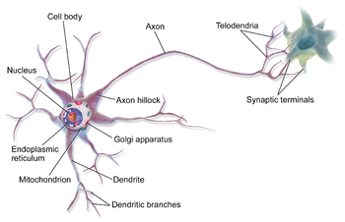
Neurons

Slide 20
Neurons
Cell body: soma. 4-100µm in diameter
In the soma, nucleus: 3-18µm size
Dendrites: input, action-potential through synapses
Axon: can be very long, up to 1.5m in humans. Electric ionic current by exchange Na⁺- K⁺, through lipid membranes via protein channels

Slide 21
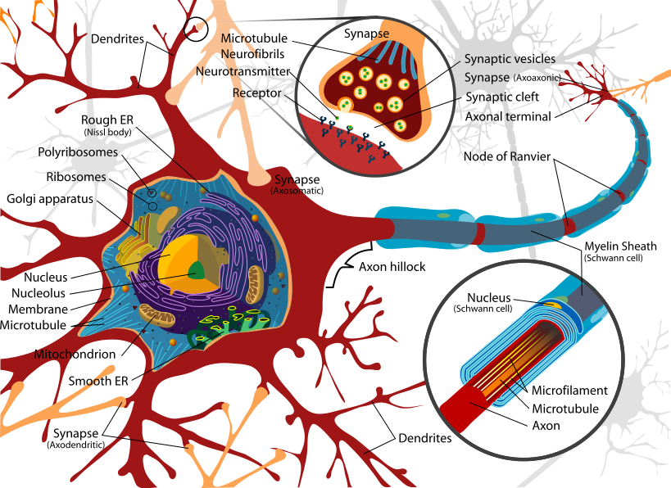
Neurons

Slide 22
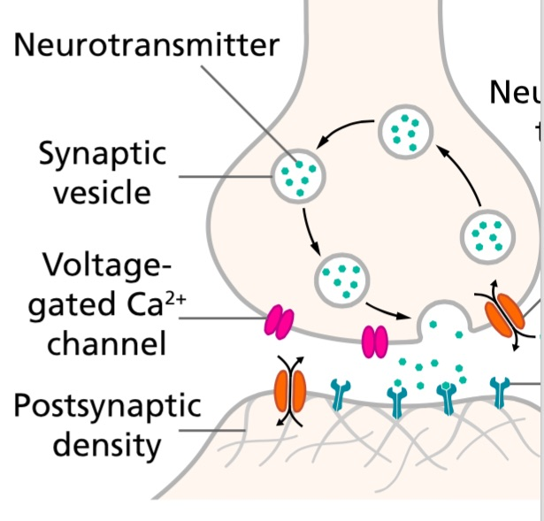
Neurons

Slide 23
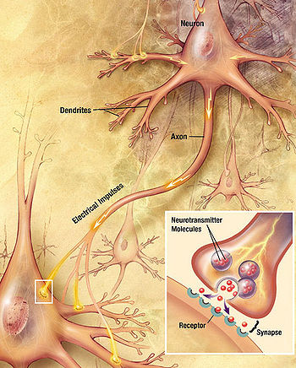
Neurons

Slide 24
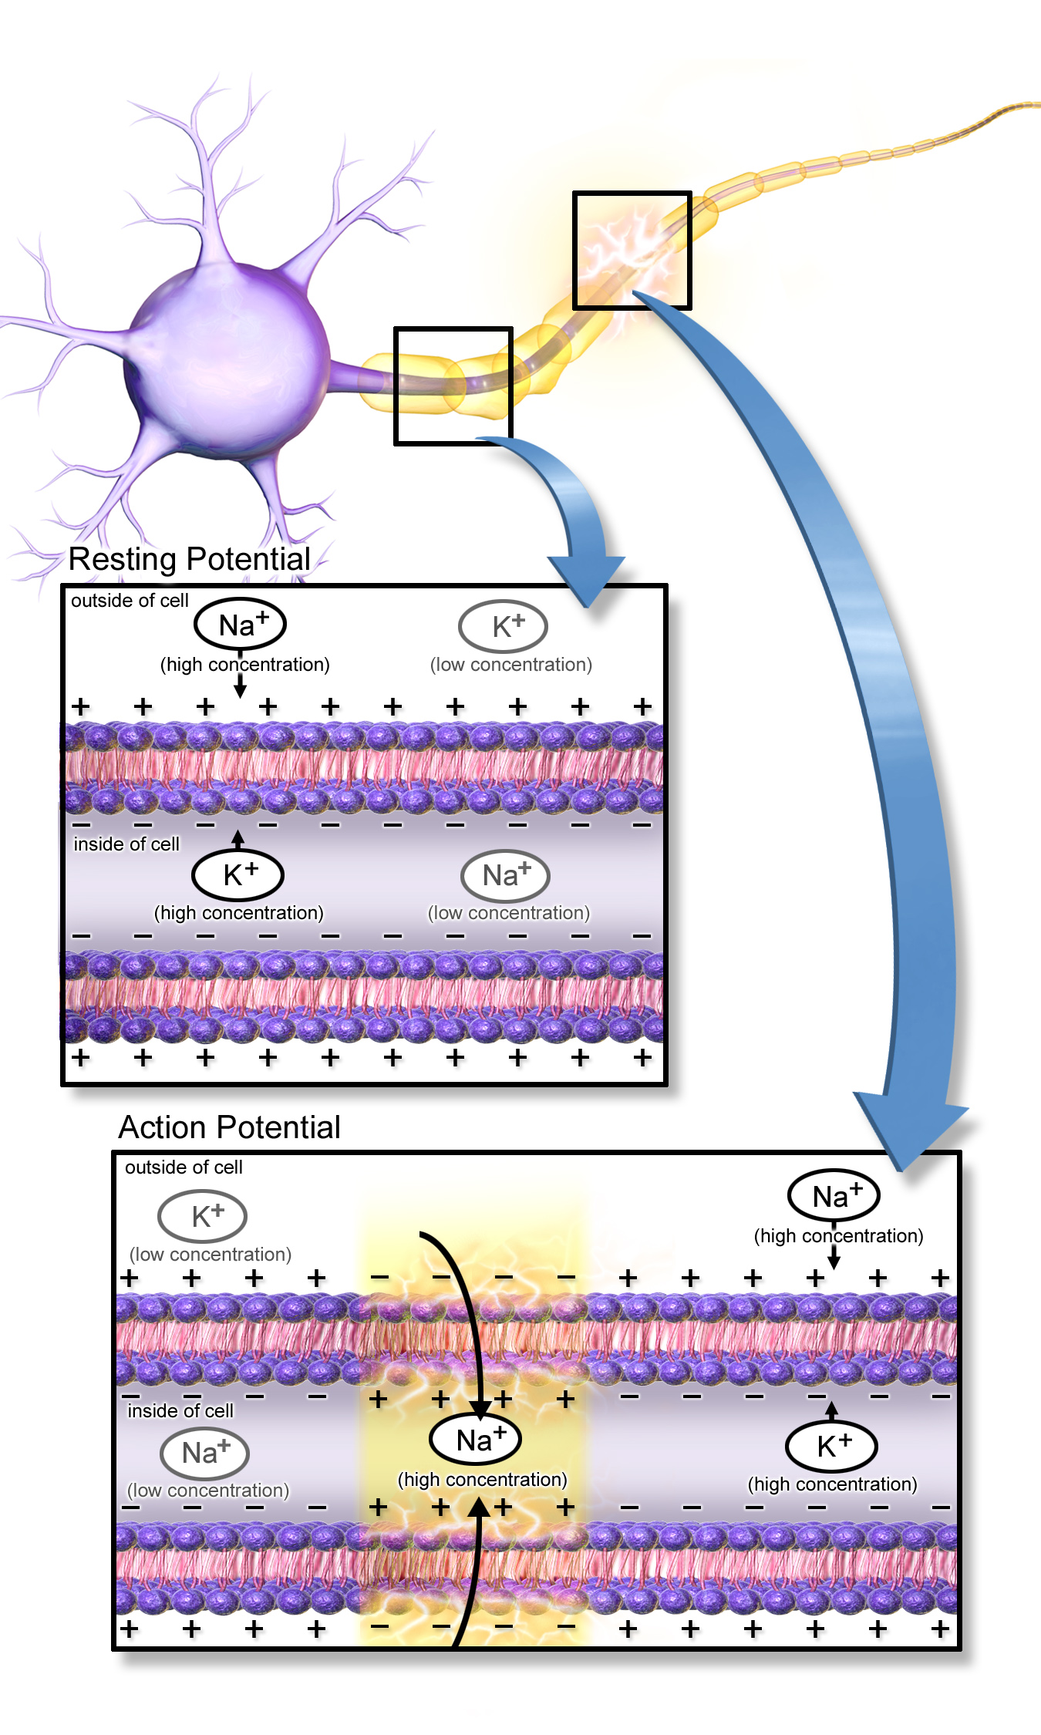
Neurons
Propagation of
ionic current
through axons

Slide 25
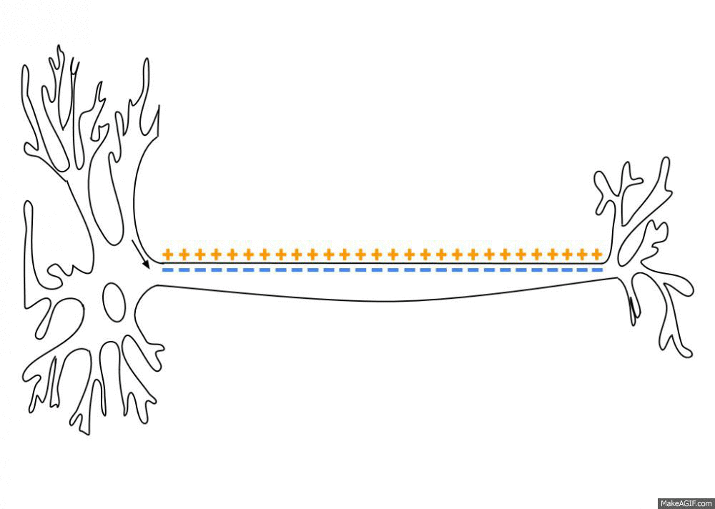
Neurons
axon hillock

Slide 26
Firing Neurons
Firing of a neuron starts at the axon hillock
resting potential is around –70 millivolts (mV) and the threshold potential is around –55 mV.
Synaptic inputs to a neuron cause the membrane to depolarize or hyperpolarize raising or decreasing the potential through the membrane.

Slide 27
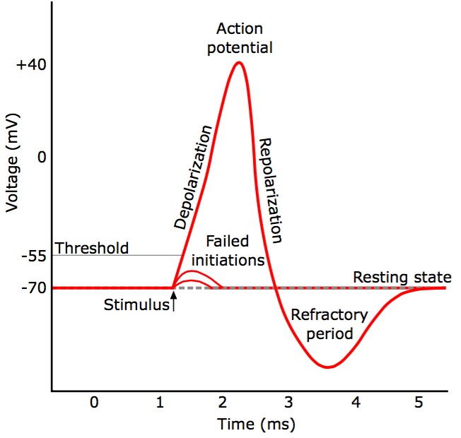
Firing Neurons

Slide 28
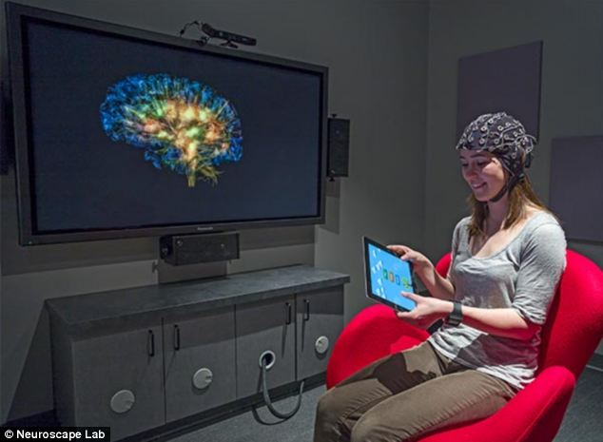
Firing Neurons
Brain-
Machine
interface

Slide 29
Firing Neurons

Slide 30
Modeling: attempt

Slide 31
An analogic digital machine
The brain does not work like a Turing machine
It cannot be simulated by a Turing machine either
Concept of emergence
The brain works as an analogic-digital machine
(Nicolelis & Cicurel, The Relativistic Brain, (2015)

Slide 32
An analogic digital machine
Cortical neurons interact through the electromagnetic field they produce when “firing”
Cortical neurons are connected to white matter through axons, creating feedback with delay
(Nicolelis & Cicurel, The Relativistic Brain, (2015)

Slide 33
An analogic digital machine
The electromagnetic field smooths out the digital nature of neurons to produce a continuum.
An effective theory should lead to a geometrical representation, in form of a Riemannian Manifold, changing in time.
(Nicolelis & Cicurel, The Relativistic Brain, (2015)

Slide 34
Antenna
What if a neuron works like an antenna ?
If so the neuron-neuron interaction is coming from the electromagnetic field emitted and received by each neuron
A mean-field approach is likely to be valid, due to the close proximity of a large number of neuron and the slow decay of the electromagnetic field in space.
Timing: firing time O(1ms), propagation time very small

Slide 35
Antenna
An antenna is an electric dipole with electric dipole moment p depending on time.
It induces a magnetic dipole moment m
It can emit a signal or receive one.
The electric and magnetic field created by dipoles are

Slide 36
Antenna
Stationary dipoles
Then

Slide 37
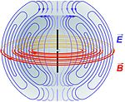
Antenna
Electric and
Magnetic Fields
Created by a
variable dipole

Slide 38
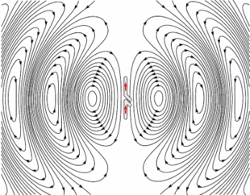
Antenna
Electric
Field

Slide 39
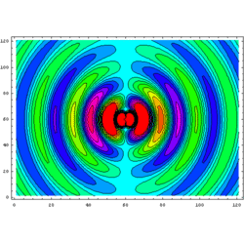
Antenna
Magnetic
Field

Slide 40
How to design a model ?
That is the question !

