Slide 1
Producing Information
Jean V Bellissard
Georgia Institute of Technology
School of Physics
Fall 2015

Slide 2
Movement & Power

Slide 3
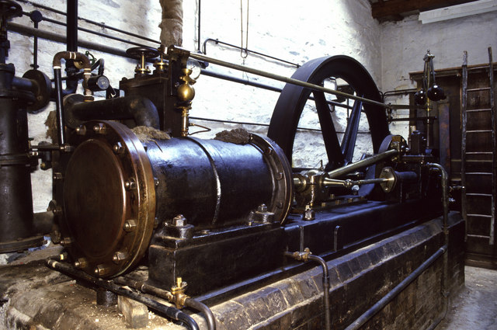
1- Thermal Machine

Slide 4
1- Thermal Machine
Denis Papin (1647-1712) pioneering invention of the steam digester, the forerunner of the steam engine, the piston and of the pressure cooker
Thomas Savery (1650–1715), steam pump, for firefighters (1698)
Thomas Newcomen (1664–1729), first practical steam engine for pumping water in mines
James Watt (1736-1819) a steam engine that produced continuous rotary motion (1781)

Slide 5
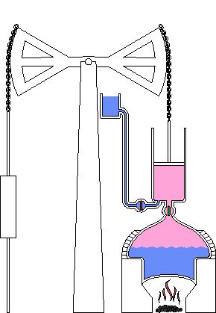
1- Thermal Machine
Newcomen steam engine.

Slide 6
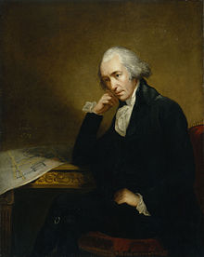
1- Thermal Machine
Watt (1736 -1819)

Slide 7
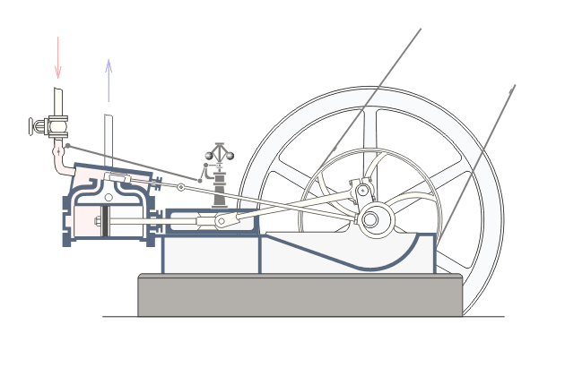
1- Thermal Machine

Slide 8
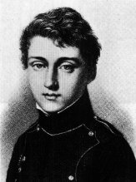
1- Thermal Machine
Carnot (1796 -1832)
Reflections on the Motive
Power of fire (1824)

Slide 9
1- Thermal Machine
Carnot’s Principle: a steam engine requires a hot source and a cold source
Q_{in} = heat received by vapor at the hot source, Q_{out} = heat lost by the vapor at the cold source, W_{out} = mechanical work produced
Q_{in}=W_{out}+Q_{out}
T_{h},T_{c} = temperature of hot, cold sources,
Thermal efficiency
η_{th}= W_{out}/Q_{in}≤ 1-T_{h}/T_{c}

Slide 10
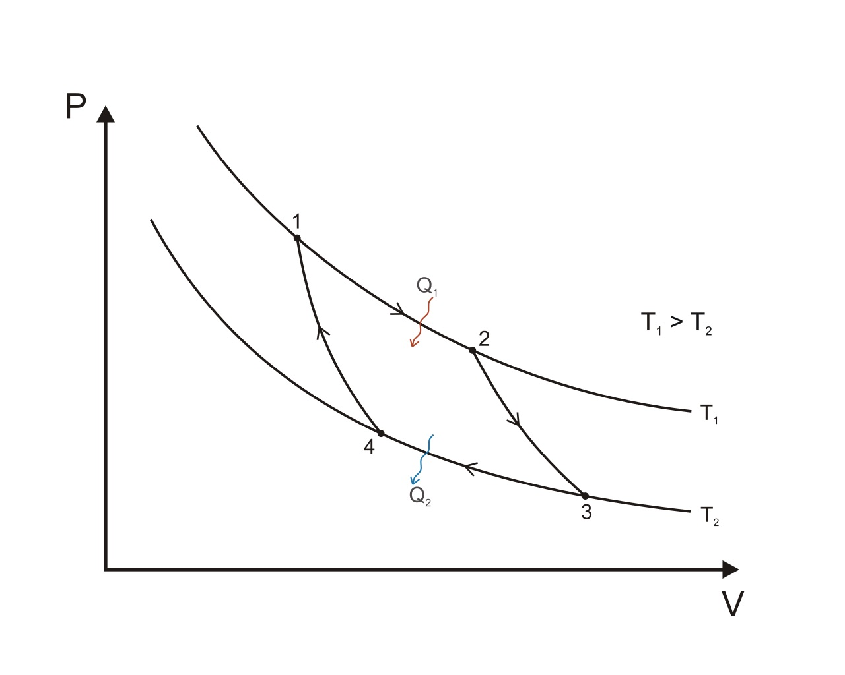
2- Carnot’s Cycle

Slide 11
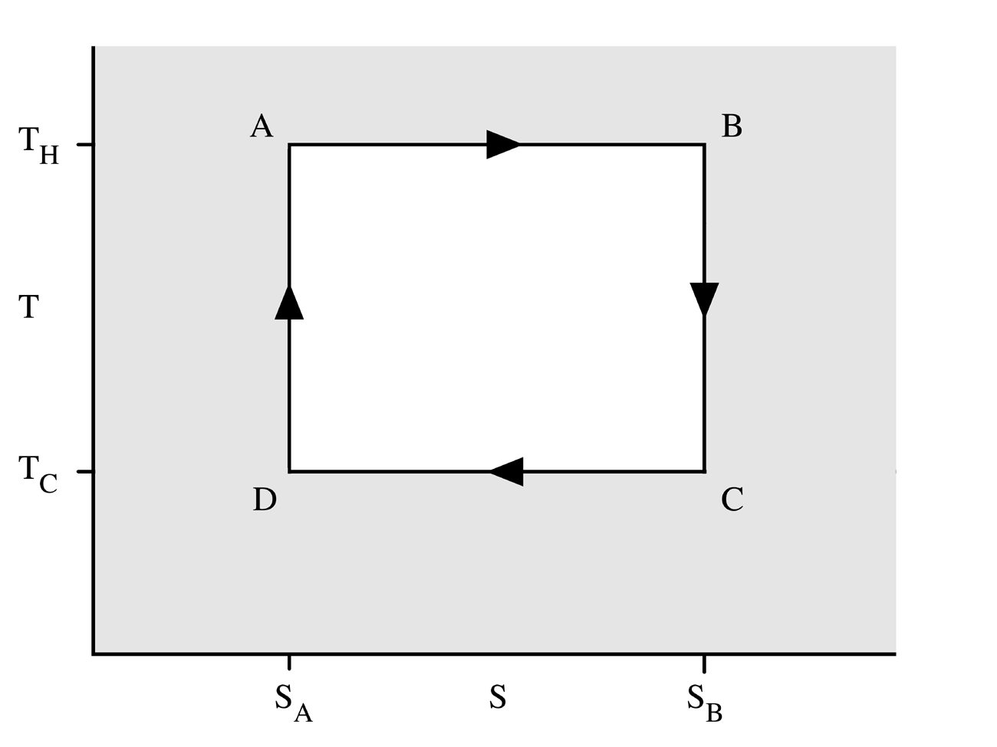
2- Carnot’s Cycle
W=(T_{H}-T_{C})(S_{B}-S_{A})

Slide 12
2- Carnot’s Cycle
W_{out}=∫_{cycle} PdV =∫_{cycle} (dQ –dU)=∫_{cycle} TdS=
W_{out}=( T_{H}-T_{C} )( S_{B}-S_{A} )
Q_{in}=T_{H} ( S_{B}-S_{A} )
Efficiency
η_{th}= W_{out}/Q_{in}= 1-T_{C}/T_{H}

Slide 13
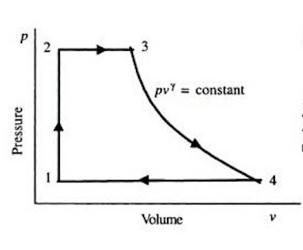
3- Rankine’s Cycle

Slide 14
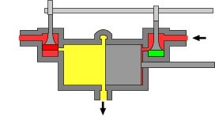
3- Rankine’s Cycle

Slide 15
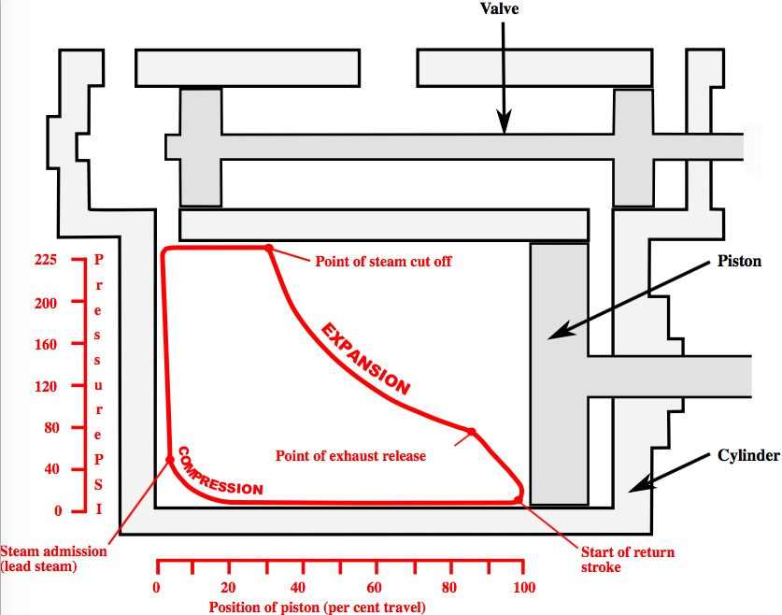
3- Rankine’s Cycle

Slide 16
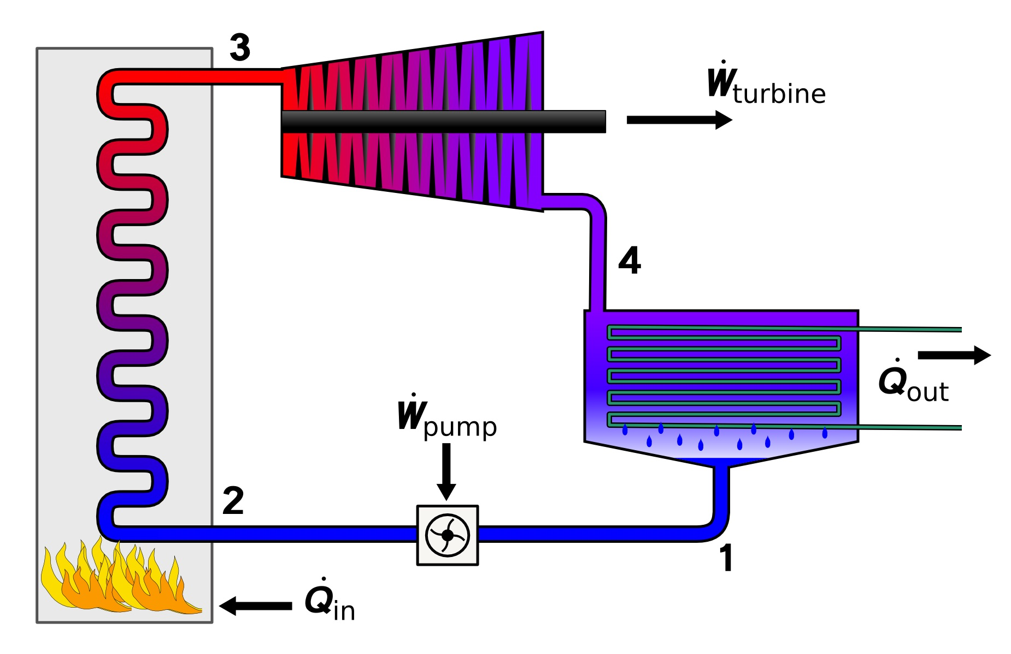
3- Rankine’s Cycle
turbine
boiler
condenser

Slide 17
4- Other Thermal Engines
Cars, truck, boat engine (gasoline, Diesel, 2-to-6 cylinders)
Aircraft Engine (kerosene, turboreactors)

Slide 18
Fabrics

Slide 19
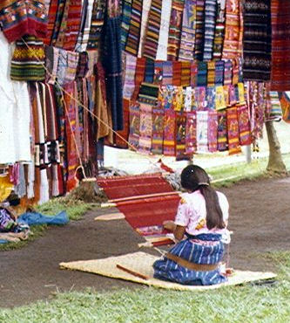
4- Loom
Traditional Indian loom
The weaver makes
complex designs, in
color and drawing

Slide 20
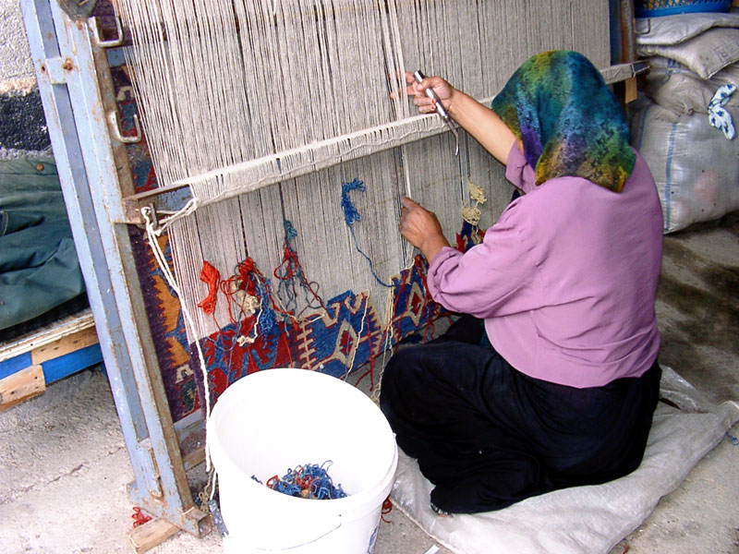
4- Loom
Vertical loom
The resulting
fabric constitutes
a piece of
information,

Slide 21
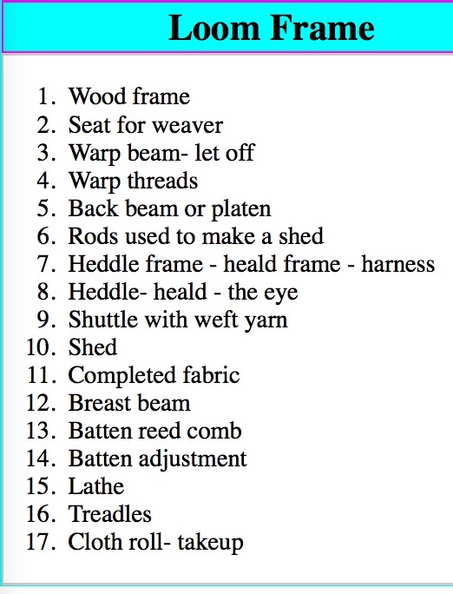
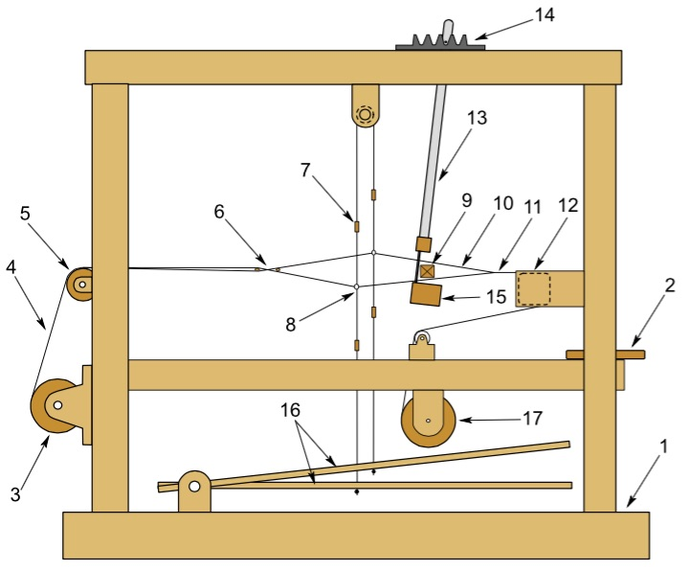
4- Loom

Slide 22
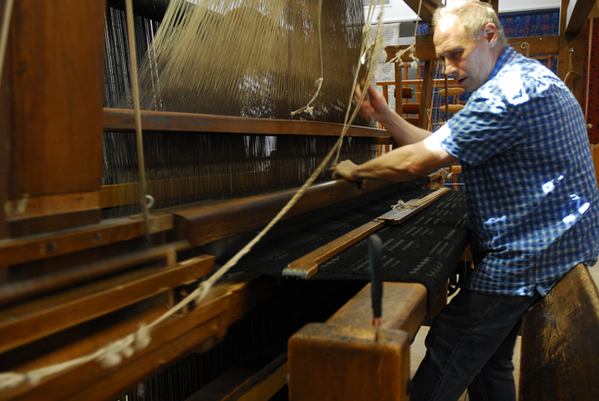
4- Loom
Jacquard loom
The design
is created
from a
punch card

Slide 23
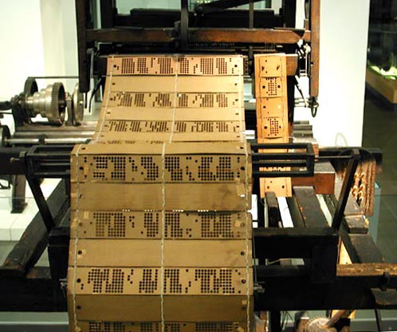
4- Loom
Jacquard loom
The design
is created
from a
punch card
= encoding

Slide 24
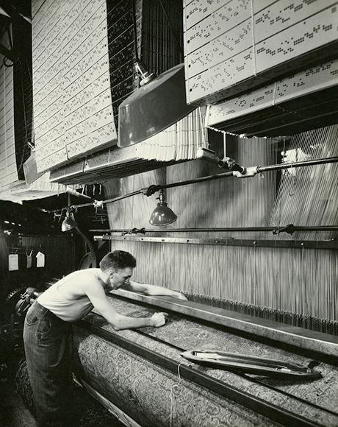
4- Loom
Jacquard loom
The design
is created
from a
punch card
= encoding
+ engine

Slide 25
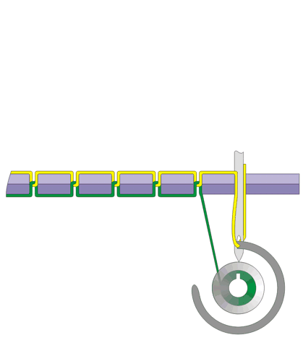
5- Sewing Machine

Slide 26
Energy Resource

Slide 27
6- Fuel
Wood, coal, oil, gasoline, methane, propane
Source of energy (examples)
Carbon C+O₂ →CO₂+33.94 kJ/g (of C)
Methane CH₄+2O₂ → CO₂+2H₂O +55.50 kJ/g
Glucose C₆H₁₂O₆ +6O₂ → 6CO₂+6H₂O +16 kJ/g

Slide 28
6- Fuel
Nuclear Energy (fission)
Uranium or Plutonium
²³⁵U or ²³⁹Pu→ fission → fast neutrons
→ moderator (water, carbon) → thermal neutrons
→ fission (chain reaction) → control bars
Outcome: heat to boil water (high pressure steam machine)

Slide 29
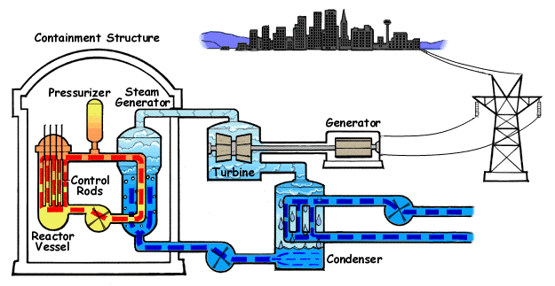
6- Fuel
W_{out}
Q_{in}
Q_{out}

Slide 30
7- Other sources of energy
Wind, Dam, Tidal waves: solar energy
Solar panels (boilers or solar cells): solar energy
Geothermal heat: radioactivity at the core of the Earth. Natural radioactivity ⁴⁰K

Slide 31
6- Waste, Heat Production, Entropy
As a result, any way to produce power results in heat production that cannot be recycled.
=> entropy production
Any information producing system creates an entropy.

Slide 32
Entropy: Who Pays for it ?

Slide 33
8- Solar Radiation
Living systems are also using engine, power, information production and produce entropy, rejected in the atmosphere.
Living systems
in the cell ATP → ADP (fuel)
From sugars to ATP (Krebs cycle)
From food to sugars (feeding, digestion)
Meat eaters → grass eaters → plants photosynthesis
UV radiation → photosynthesis

Slide 34
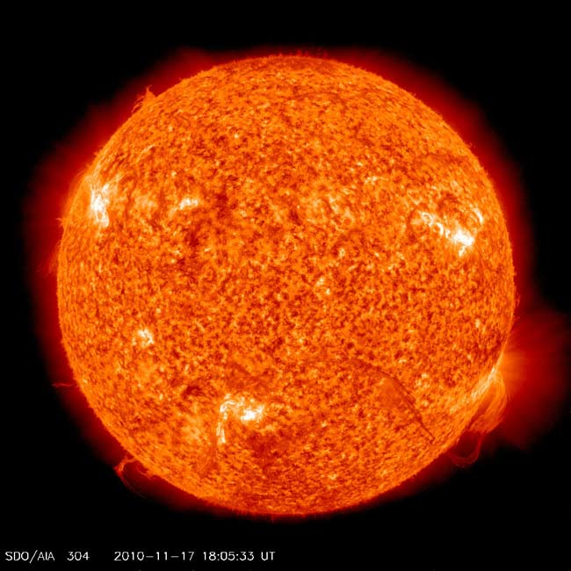
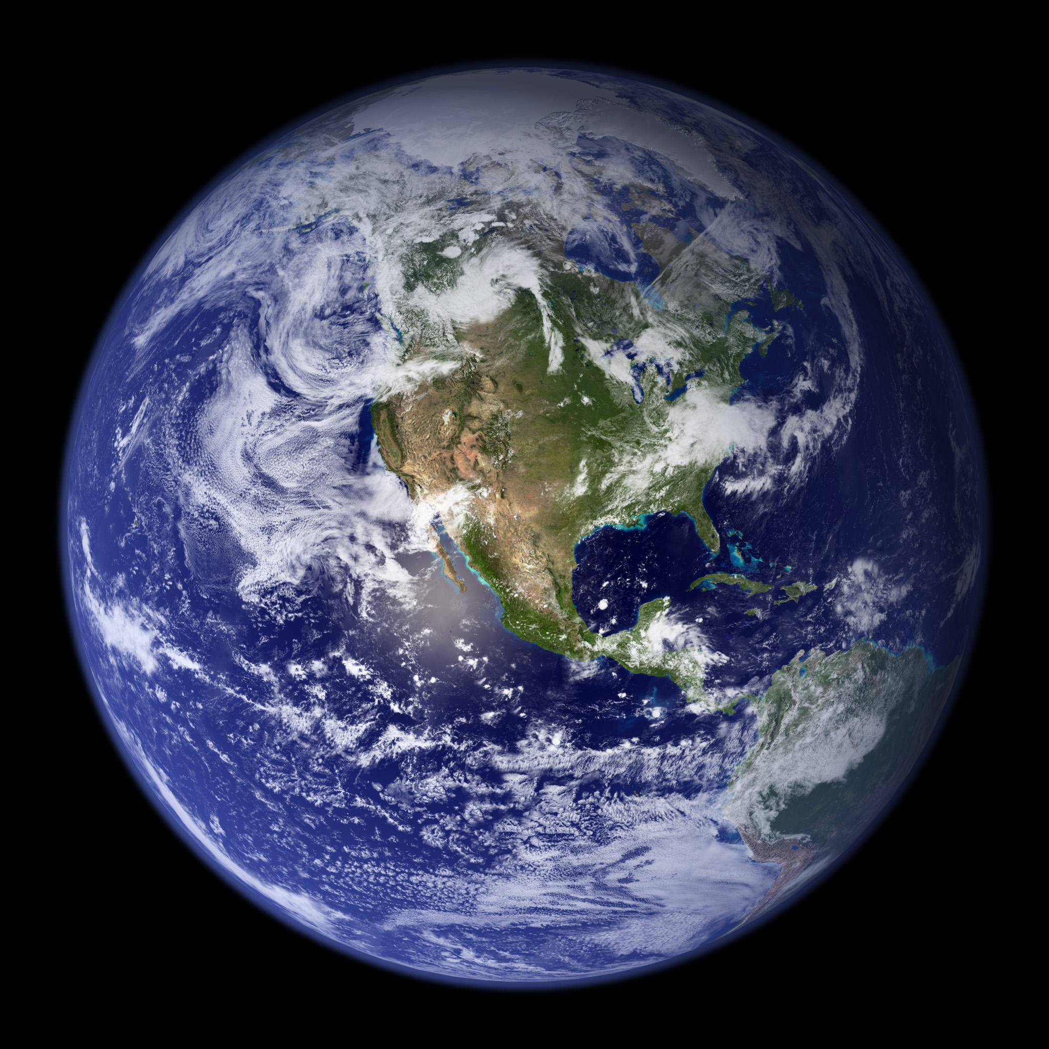
8- Solar Radiation
Black-body radiation
IR
UV

Slide 35
8- Solar Radiation
Black-Body Radiation
Wien’s Law for energy density u= σ T⁴
Entropy density s, satisfies ∂s/∂u=1/T. This gives
S=4/3 σT³
If Φ denotes the flux of photon (arriving or emitted) the power is P=Φu.
Energy conservation P_{in}=P_{out}

Slide 36
8- Solar Radiation
This gives
Φ_{in}/Φ_{out}=u_{out}/u_{in}=(T_{E}/T_{S})⁴
Therefore the ratio of the entropy production rates is
Φ_{in}s_{in}/Φ_{out}s_{out}=u_{out}/u_{in}=T_{S}/T_{E}≈20
The incoming UV radiation becomes outgoing IR radiations and the latest are producing the excess of entropy production rate

